Slide 1
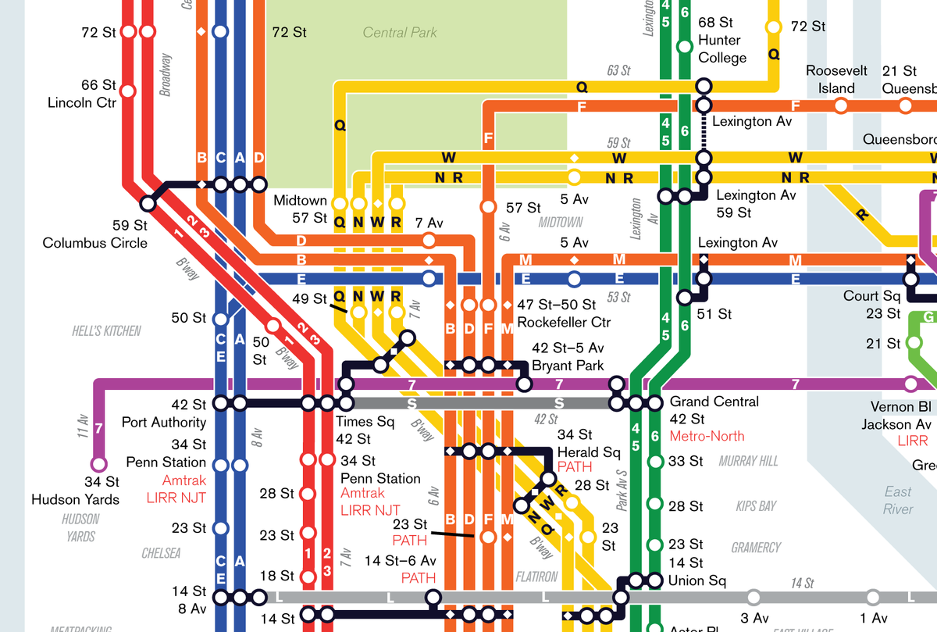
Data Analysis for Alsayegh Charitable Foundation
Nisreen Alsayegh

Slide 2
Back story:
Al-Sayegh Charitable Foundation wants to establish a charity market during the summer season Alsayegh charitable foundation wants to take advantage of crowded stations to establish the market near to one of the train stations.

Slide 3
Dataset
MTA: data files containing numbers of cumulative entries and exits and stations, turnstile, dates and time
Dataset: from June 22, 2019 to September to 28, 2019. Because it is the duration that corresponds with the summer season .
Rows 3100324
columns 11

Slide 4
Tools :
Python
Jupyter notebook
Matplotlib
NumPy
SQLAlchemy
Seaborn
Pandas

Slide 5
Cleaning data :
Check nulls: no nulls
Fix Columns : Strip column names
Add new columns : DATE and Daily Entries After
Check Duplicates: drop the duplicate

Slide 6
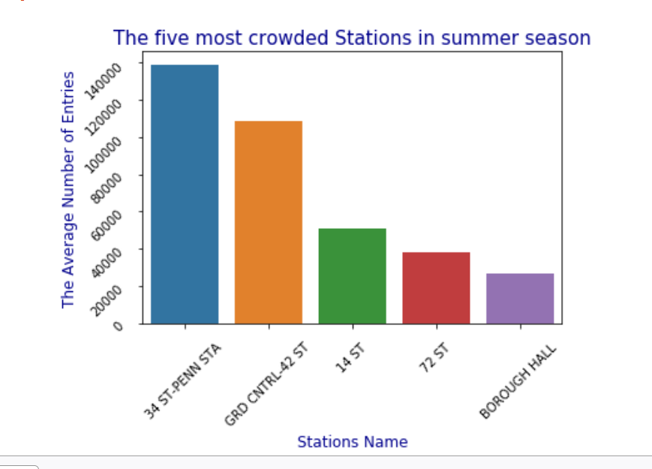
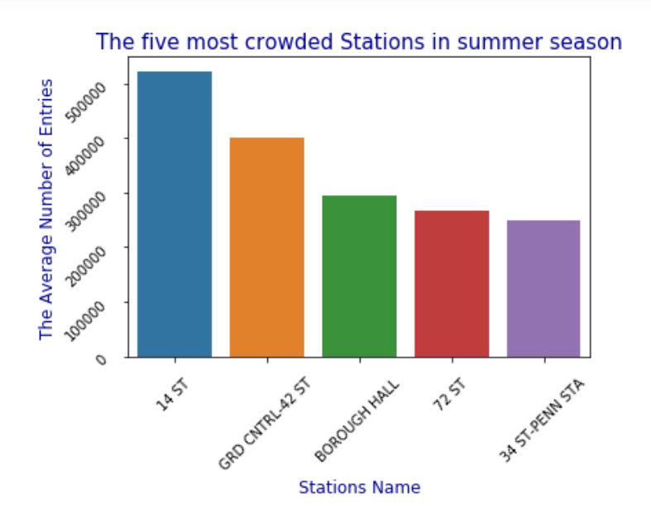

Bar chart before and after cleaning the data
After
Before

Slide 7
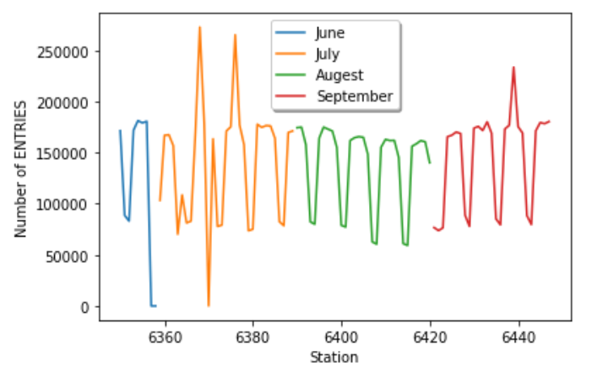
The most crowded month

Slide 8
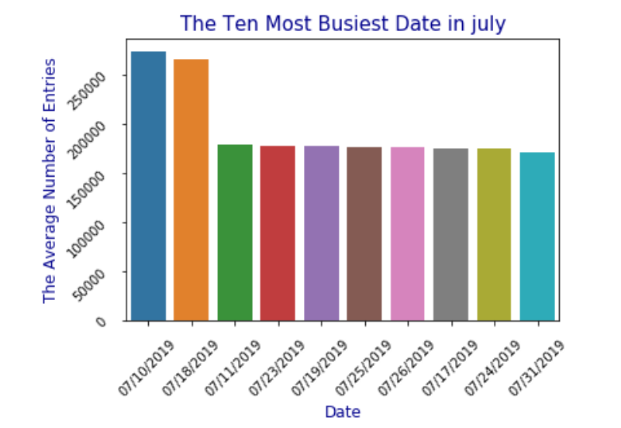
The most crowded date

Slide 9
Conclusion:
We suggest to alsayegh charitable foundation to establish the market in 10th of July near to 34 ST-PENN STA that located at the intersection of 34th Street and Seventh Avenue.

Slide 10
Conclusion:
We suggest to alsayegh charitable foundation to establish the market in 10th of July near to 34 ST-PENN STA that located at the intersection of 34th Street and Seventh Avenue.

Slide 11
Future work :
Determine the best time to establish the market
Get additional data to study the income for the residents of the area

Slide 12
Thank you

